Slide 1
Natural language processing to determine frontiers in AI-based medical diagnosis using NIH award data
Interval Analysis

Slide 2
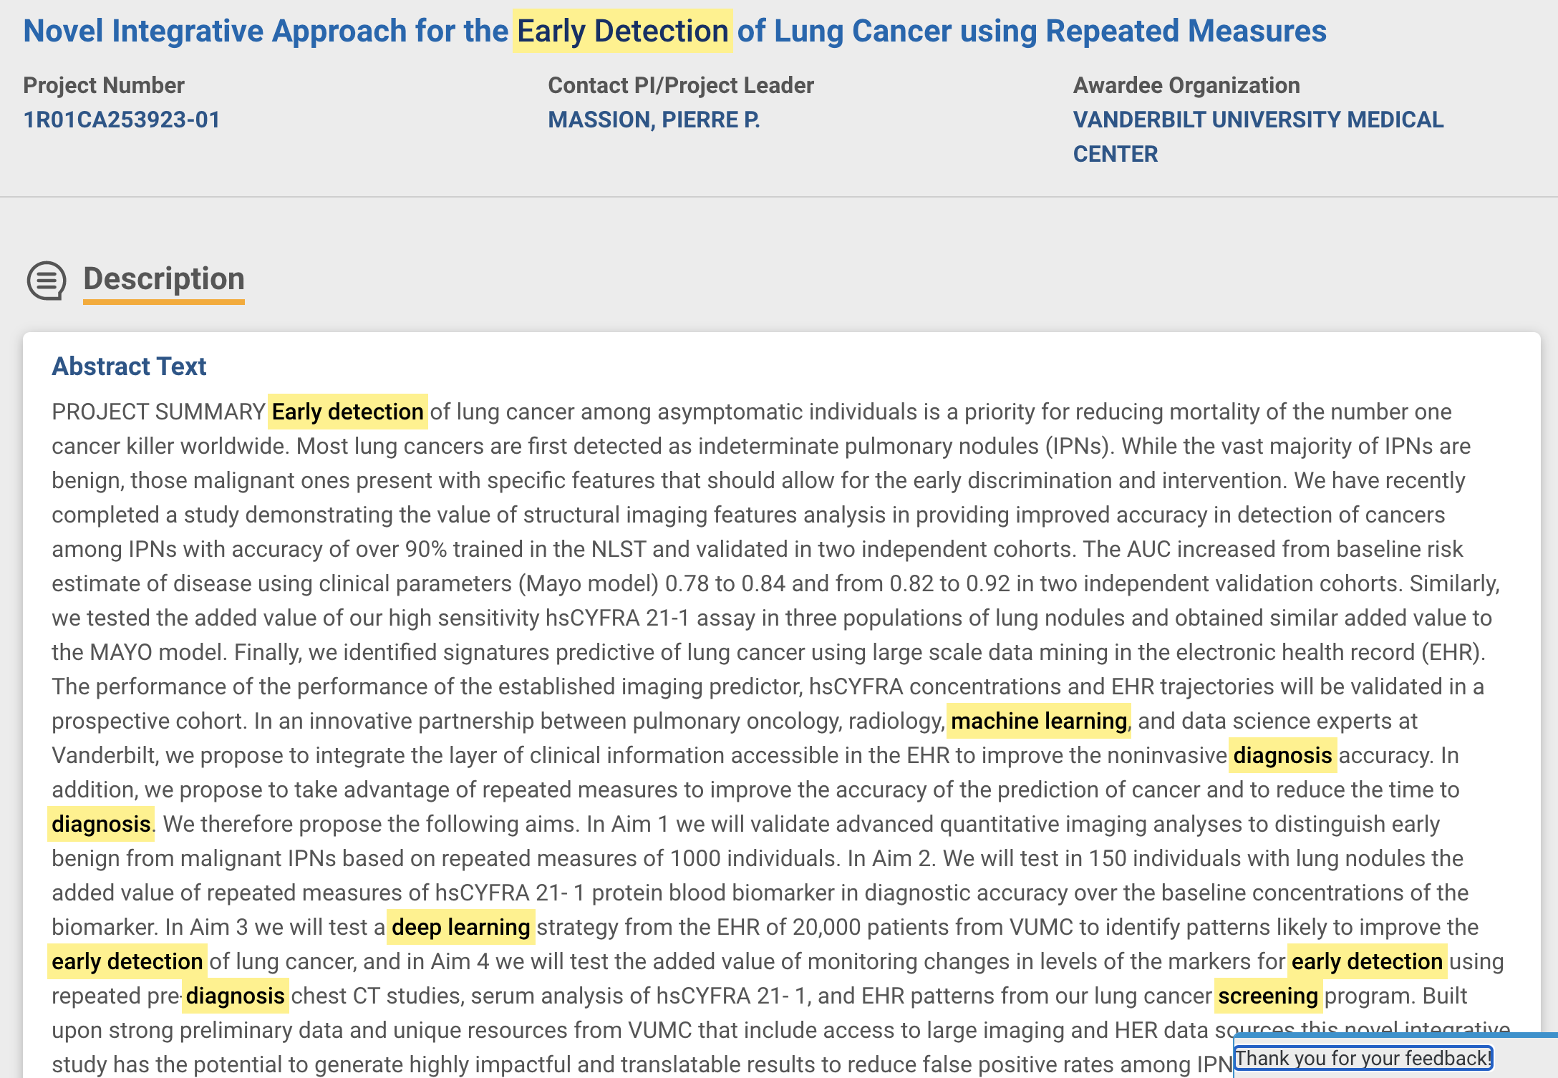
Method
Search for awards from 2000-2020 in NIH reporter database
Query focused on AI + diagnostics: ﻿
("Artificial Intelligence" or "Machine Learning" or "Deep Learning" or "Natural Language Processing" or "Random Forest" or "Logistic Regression" or "LSTM" or "RNN" or "CNN" or "Federated Learning" or "Decision Tree" or "Support Vector Machine" or "Bayesian Learning" or "Gradient Boosting" or "Computational Intelligence" or "Naive Bayes" or "Computer Vision") and ("Diagnosis" or "Early Detection" or "Decision Support" or "Screening")
Unsupervised NLP to generate categories
K means
Combine abstract + title + project relevance as input
Train with top 200 word features
Analyze centroids (key terms from each cluster) to describe categories

Slide 3
Cluster | Description | Size | Terms
0 | ??? Drug discovery | 576 | drug discovery model cell effect human data computational system novel method patient disease treatment development project screening network research identify
1 | Clinical decision support | 648 | data research clinical system health tool information support model method learning project new training decision develop development aim patient analysis
2 | Novel biomarkers | 214 | disease patient clinical biomarkers early study research aim treatment method diagnosis data detection project diagnostic identify develop test progression using
3 | Breast cancer screening | 475 | breast cancer woman risk detection screening imaging patient tumor decision image model system study feature clinical diagnosis data develop tool
4 | Neurocognitive disease | 129 | ad disease cognitive brain biomarkers imaging data project change risk mri early clinical aim study trial individual progression novel model
5 | Clinical risk scoring | 372 | patient care risk health clinical data outcome treatment study use research medical system aim intervention model factor project record improve
6 | Molecular diagnostics | 434 | protein cell human interaction function molecular disease target model technology computational method new aim data gene functional project approach analysis
7 | Brain cancer (esp. response to therapy) | 438 | tumor cancer cell imaging patient image tissue therapy treatment brain clinical response molecular mri approach model develop diagnosis technology aim
8 | Behavioral | 806 | brain disorder cognitive neural functional imaging study research project data individual aim pattern mechanism development control symptom behavior model learning
9 | Imaging | 290 | image imaging detection system technique patient analysis clinical cancer project method develop mri data diagnosis algorithm research new diagnostic disease
10 | Lung cancer screening | 231 | cancer lung patient risk screening data study detection clinical tumor early treatment research aim method project diagnosis model develop biomarkers
11 | ??? Cancer screening | 249 | screening woman intervention risk study cancer test among group health control factor care patient treatment primary outcome age rate model
12 | Genomics | 589 | gene genetic disease risk study phenotype data association aim identify factor disorder human analysis complex method molecular clinical novel cell
13 | Development | 220 | child language disorder early study project research aim intervention care year outcome health risk development age data clinical diagnosis diagnostic
14 | High-risk populations | 288 | hiv testing risk behavior care among use drug intervention health research study treatment data patient population using outcome algorithm new

Slide 4
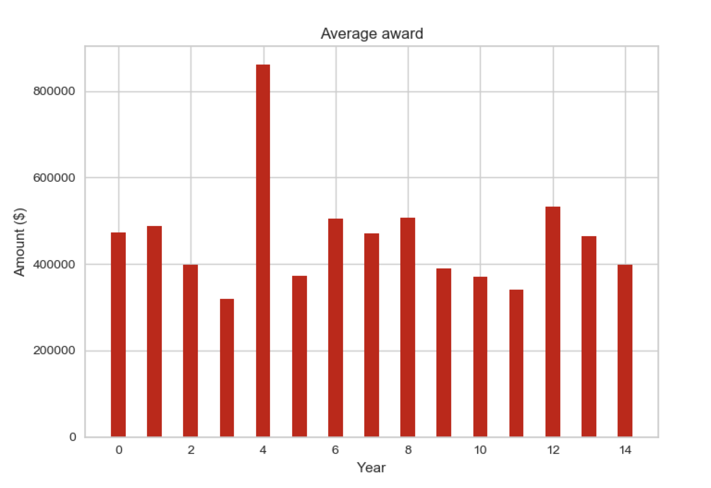
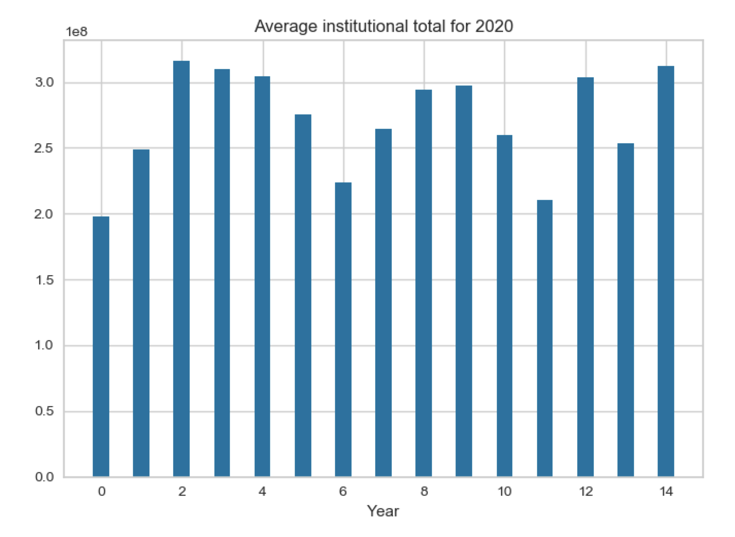
Average award size and institutional funding by cluster
Highest average award: Cluster 4 (Neurocognitive disease)
Lowest average award: Cluster 3 (Breast cancer screening)
Highest funded institutions: Cluster 2 Novel biomarkers)
Lowest funded institutions: Cluster 0 (??? Drug discovery)

Slide 5
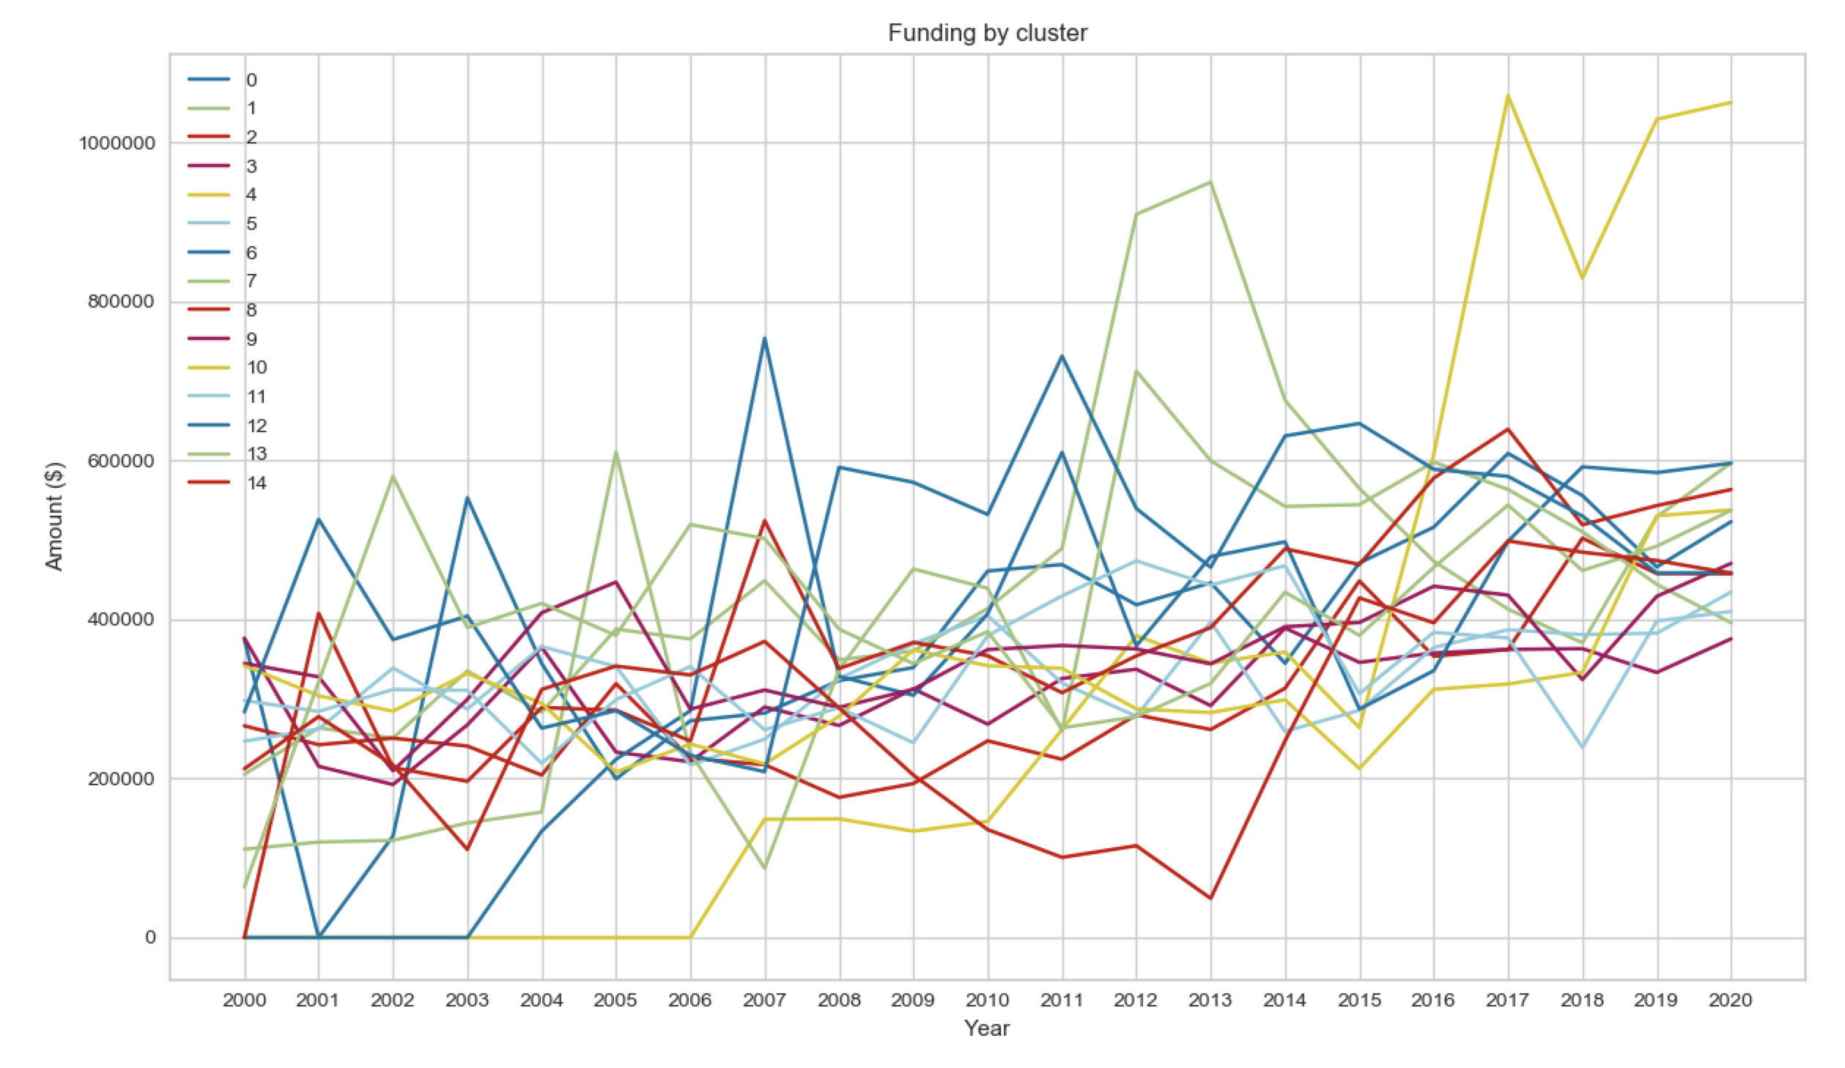
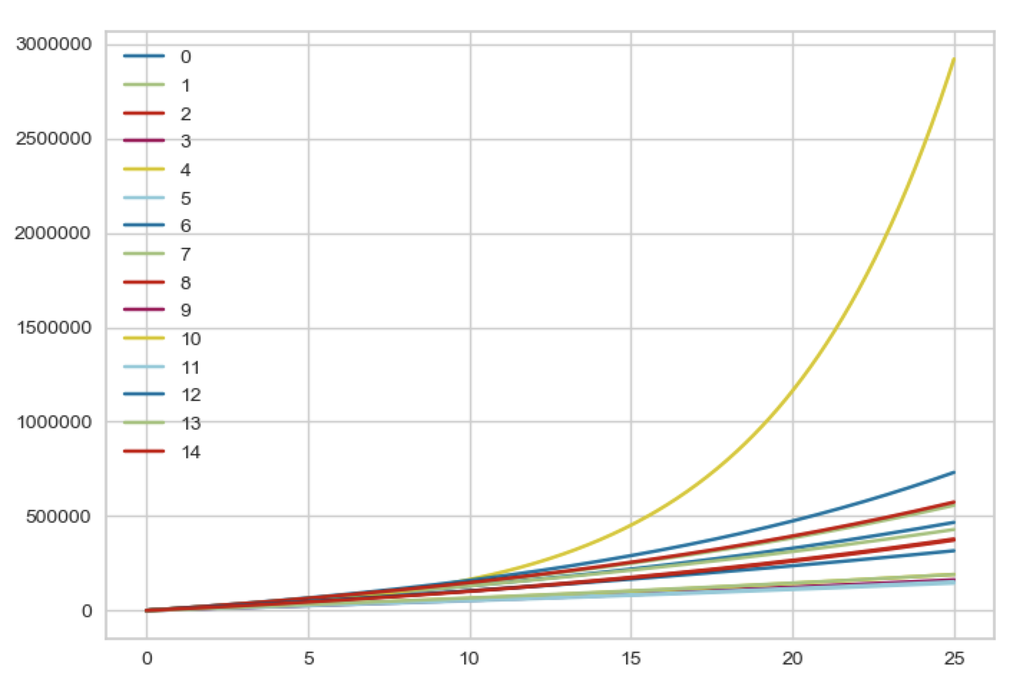
Funding by year: Actual and projected
Highest projected growth
1. Cluster 4 (Neurocognitive disease)
2. Cluster 12 (Genomics)
3. Cluster 8 (Behavioral)

